Slide 1

Power Bi Enabled Comprehensive Analysis on Unicorn Businesses

Slide 2
Table of Contents
01
Week 1
02
Week 2
03
Week 3
04
Week 4
Data Acquisition and Data Modelling
Analysis using DAX Functions
Visualization and Dashboard Preparation
Formatting and Project Testing

Slide 3
Industry Use Cases
Unicorn Businesses
Private companies with a valuation over $1 billion as of March 2022, including each company's current valuation, funding, country of origin, industry, select investors, and the years they were founded and became unicorns.
This project establishes various metrics in order to convert a business into Unicorn business. Here which country has most of the Unicorns, which group invest for the most of the Unicorns, good year for establishing Unicorns, various Unicorn industries etc. were identified which are very useful for the youth who want to establish or convert their business into Unicorns.

Slide 4
Project Introduction
In this Project, CSV Data Source based Data Analysis is implemented. Using this approach, we can unlock valuable insights and drive significant business dynamics.
Main Objectives:
﻿﻿Which Company having highest return on investment?
﻿﻿Which country had most unicorns?
﻿﻿Which Year has most of the unicorns?
﻿﻿Number. of Years to become a company to Unicorn?
Which investor founded most of the Unicorns?

Slide 5
Project Methodology
Data Acquisition and Importing:
Connect to Data Sources
Import and Transform Data
Preparation of the Data(Pre Processing):
Clean the Data to remove Duplicates, nulls etc.
Understand the Data and Transform the Data
Identify Dynamics of the Business:
Use DAX to add value to the data
Calculate Descriptive Statistics
Visualization and Testing:
Converting insights into visuals and Testing
Story Telling:
Present the Project before the stakeholders

Slide 6
Week 1
01
Data Acquisition and Importing
Preprocessing of Data

Slide 7
Data Acquisition and Importing

Slide 8
About Dataset
A unicorn company is a privately held company with a current valuation of over $1 billion USD. This dataset consists of unicorn companies and startups across the globe as of April 2022, including country of origin, sector, select investors, and valuation of each unicorn.
The data dictionary of the dataset is given below:
Company | Company Name
Valuation | Company valuation in billions (B) of dollars
Date Joined | The date in which the company reached $1 billion in valuation
Industry | Company industry
City | City the company was founded in
Country | Country the company was founded in
Continent | Continent the company was founded in
Year Founded | Year the company was founded
Funding | Total amount raised across all funding rounds in billions (B) or millions (M) of dollars
Select Investors | Top 4 investing firms or individual investors (some have less than 4)

Slide 9
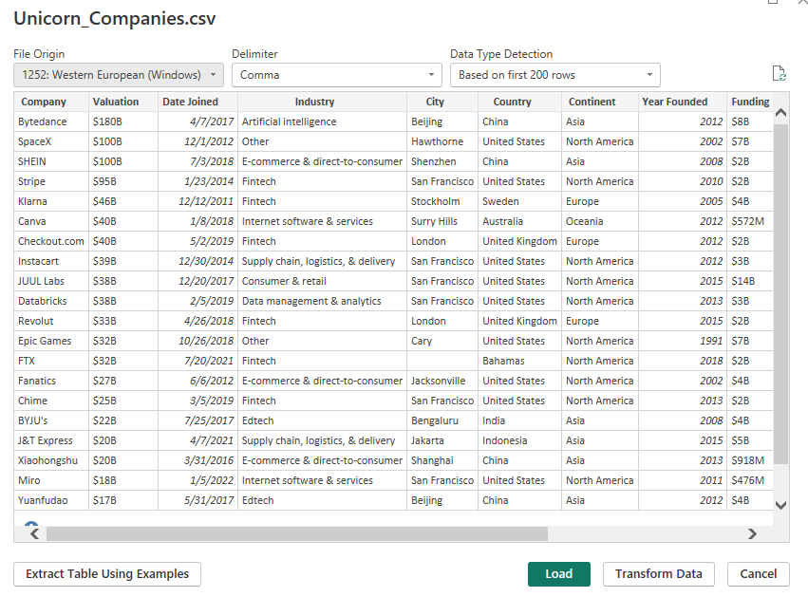
Importing Data from CSV file
Here, we got data from the saved CSV file of the dataset named Unicorn_Companies.csv to the Power BI Desktop.

Slide 10
Preparation
of Data

Slide 11
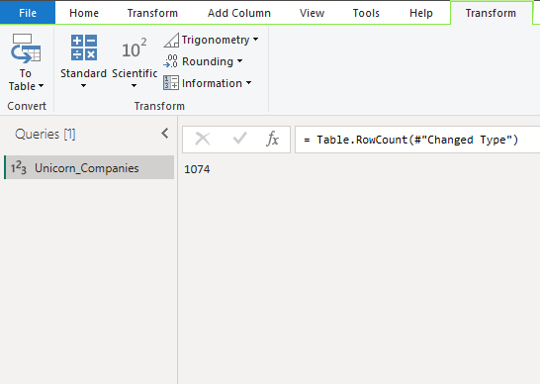
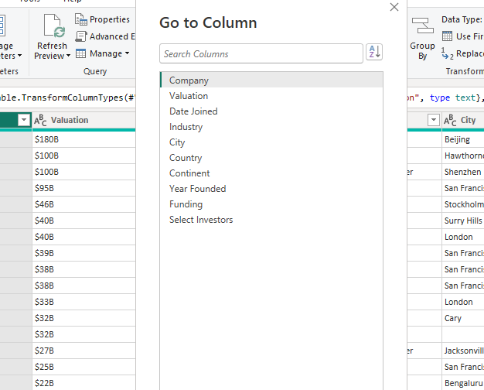
Understanding the Data
After clicking on Transform Data, the Power Query editor opens. Under Transform tab, we click on Count Rows to get the total number of rows in the dataset. Consequently, we get the total number of columns under Home tab. We can also use the following DAX expression to get row count:-
= Table.RowCount()
Therefore, there are 1074 rows and 10 columns present in the dataset.

Slide 12
Preprocessing of Data
Data preprocessing/preparation/cleaning is the process of detecting and correcting (or removing) corrupt or inaccurate records from a dataset, or and refers to identifying incorrect, incomplete, irrelevant parts of the data and then modifying, replacing, or deleting the dirty or coarse data.
The following steps were applied to preprocess the data:-
Checked the Data Type for each Column.
Replaced S and B from Valuation Column to Blank and Changed the Column name to Valuation (in $ B).
Replaced Data Type of Valuation Column from Text to Fixed Decimal Number.
Replaced all Unknown values in Funding Column to $0 B.
Splitted Funding Column by Digit to Non Digit method.
Replaced $ in Funding column to Blank, rename funding.1 to Funding value and funding.2 to Funding (B or M).
Changed the data type of Funding value column to Fixed Decimal Number.
Created New Column ‘Funding’ using DAX as follows:
Funding(in $ Billions) = IF(Unicorn_ Companies[Funding B or M]="M",
Unicorn_Companies[ Funding Value]/1000,Unicorn_Companies[Funding Value]
Created New Column ‘Year Joined’ using DAX as follows:
Year Joined = YEAR(Unicorn_Companies[Date Joined])

Slide 13
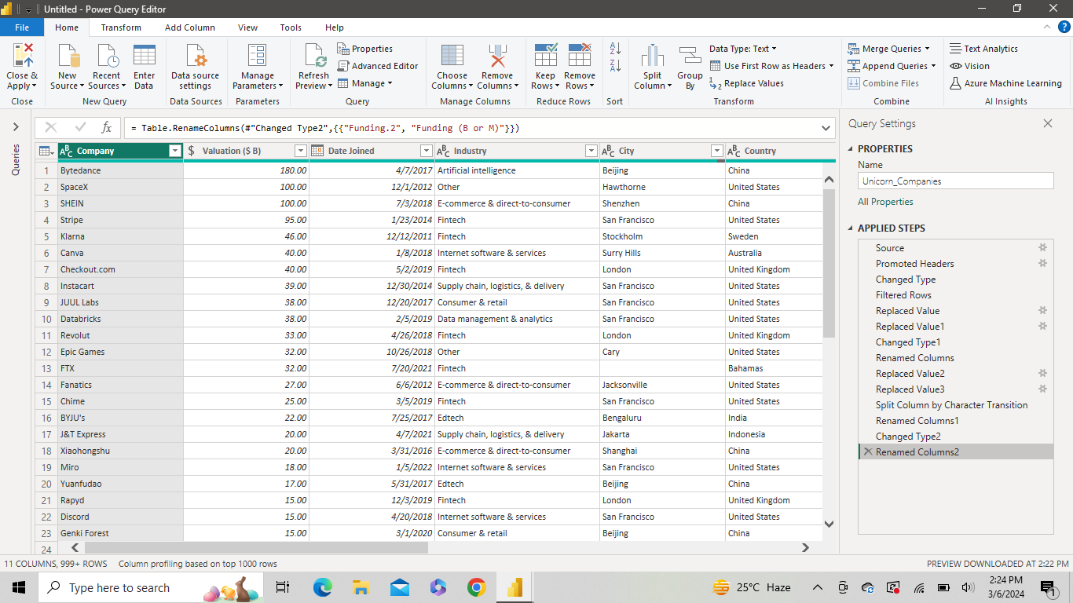
Power Query Editor after Transformation

Slide 14
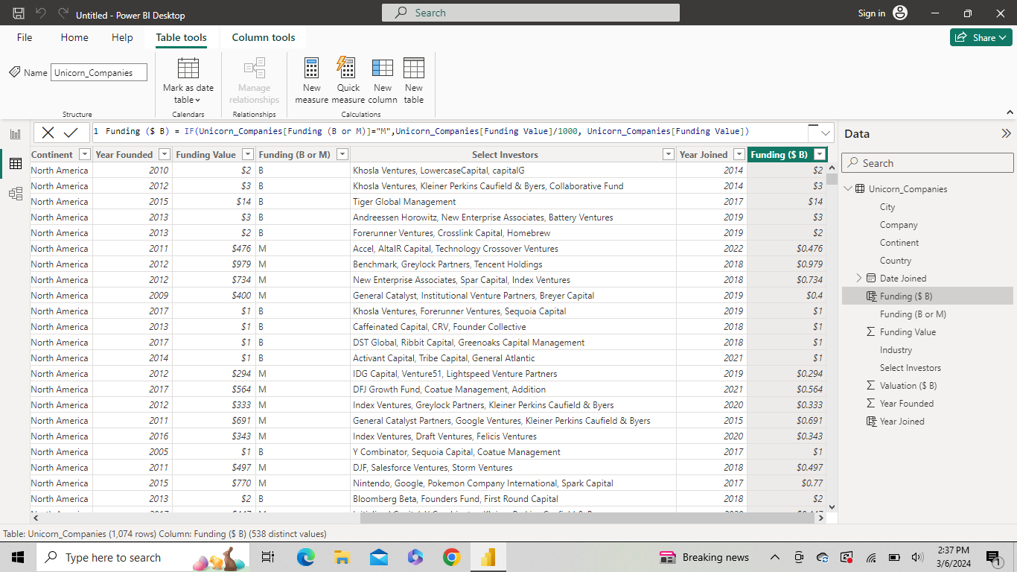
Loaded the Data in Power Bi Desktop

Slide 15
Week 2
02
Analysis using DAX function
Visualization

Slide 16
Exploratory Data Analysis

Slide 17
Creating Slicers and Measures
Created six (6) slicers for six columns of the dataset as follows:
Slicer 1 -> Year Joined
Slicer 2 -> Company
Slicer 3 -> Country
Slicer 4 -> Continent
Slicer 5 -> City
Slicer 6 -> Industry
Created New Measure to calculate Valuation to Funding ratio as follows:
Valuation to Funding Ratio = DIVIDE(SUM(Unicorn Companies Valuation (in $B), SUM(Unicorn Companies[Funding (in $B)])
Created New Measure to calculate No. of Years to become a company to Unicorn as follows:
Years to become Unicorn = abs(Unicorn Companies[Year Joined] - Unicorn Companies[Year Founded] < 0)

Slide 18
Visualization of Data

Slide 19
Visualization of Data
Question 1: Which Company is having highest Return on Investment (ROI)?
Created Matrix chart
Rows: Company
Values: Valuation to Funding to Evaluation Measure
Sorted in descending order to know the company having highest return on investment
Answer: Zapier company has the highest ROI
Question 2: Which country has the most unicorns?
Created Map chart
Location: Country
Bubble size : count of Company
Answer: USA country has the most of the unicorns

Slide 20
Visualization of Data
Question 3: Which Year has the most number of unicorns?
Created Stacked column chart
X axis: Year Joined
Y axis : Count of company
Filtered this visual to show greater than 2015 year onwards
Answer: 2021 year has the most number of unicorns
Question 4: No. of Years for a company to become a Unicorn
Created a Card Visual for Average Years to become Unicorn
Answer: 7 Years

Slide 21
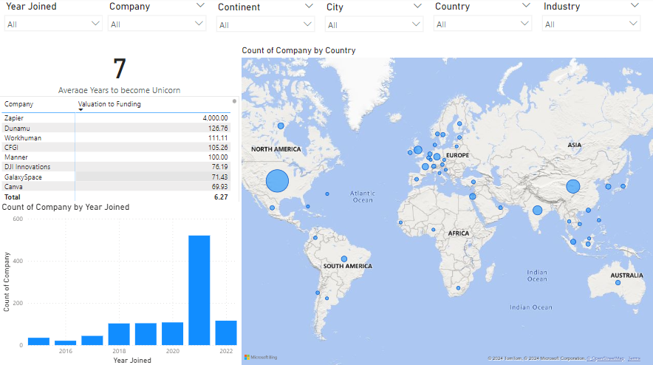
Visualized the Data

Slide 22
Week 3
03
Advanced Visualization
Dashboard Preparation

Slide 23
Advanced Visualization

Slide 24
Visualization of Data
Question 5: Which Investor founded most of the Unicorns?
Created new table named Investor Data by:
Creating a reference to the original table.
Splitted Select Investors column by choosing Comma delimiter by Rows.
Created Donut chart
Legend: Select Investor from Investors Data
Values : Count of Select Investor from Investors Data
Answer: Tiger Global Management Investor Group founded most of the Unicorns (41 Unicorns founded).

Slide 25
Dashboard Preparation

Slide 26
Analysis of KPIs
Created Card Visual for the following key performance indicators (KPIs):
Total Valuation (in Billion Dollars)
Total Funding (in Billion Dollars)
Number of Companies
Number of Countries
Number of Industries
Number of Cities
Number of Continents

Slide 27
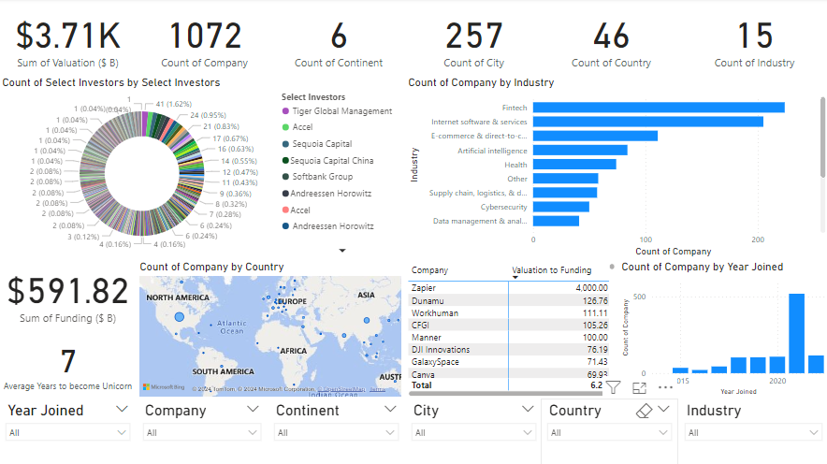
Basic Dashboard

Slide 28
04
Week 4
Formatting the Dashboard
Project Testing

Slide 29
Dashboard Formatting

Slide 30
Formatting and Adding Pages
We formatted the dashboard and the visuals according to a specific theme and background and added four (4) pages to the report, mainly :
Page 1
This is the title page for the Power BI report consisting the name of the project and three (3) buttons named, KPIs, Analysis and Insights.
Page 2
This page shows the KPI dashboard consisting of all the KPIs of the dataset.
Page 3
This page shows the Analysis dashboard consisting of all the analysis done with the help of visuals.
Page 4
This page shows the Insights dashboard consisting of all the insights and conclusions gathered from the analysis.

Slide 31
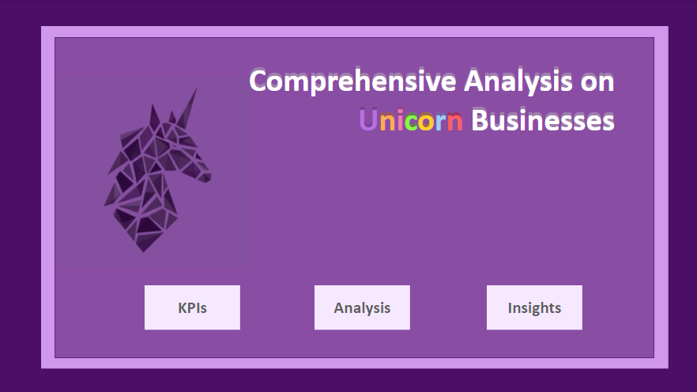
Title Page

Slide 32
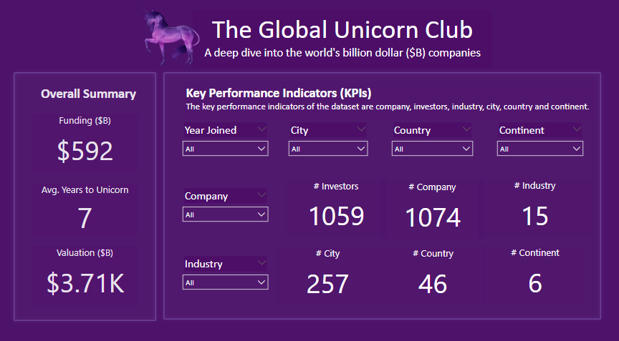
KPI Dashboard

Slide 33
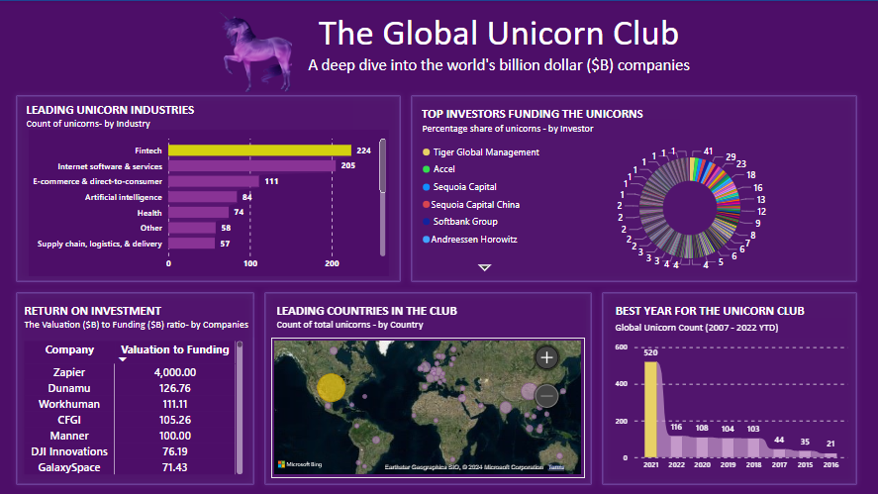
Analysis Dashboard

Slide 34
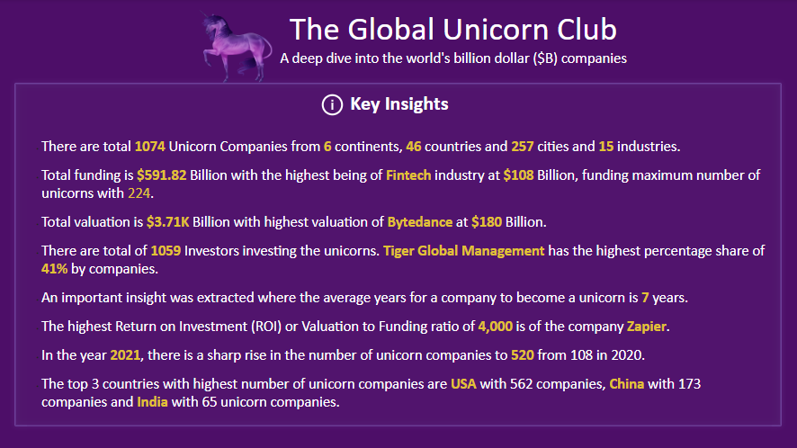
Insights Dashboard

Slide 35
Future Scope
Provide an in-depth analysis on the basis of geographical and sectional areas by adding more pages and utilizing more visualization metrics in the report.
﻿﻿Utilize machine learning algorithms for anomaly detection, predictive modeling, and automated insights generation.
﻿﻿Integrate NLP features for conversational data exploration and analysis.

Slide 36
Thank You!

